Slide 1
SharePoint Online Management and Control
Chris Bortlik
Productivity Architect
Microsoft
@cbortlik

Slide 2


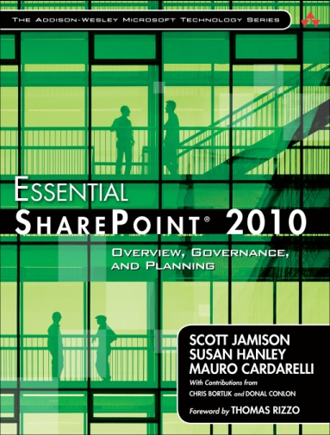
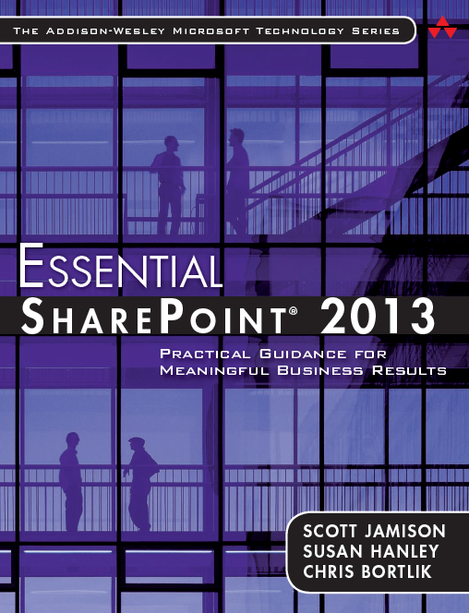
Meet Chris Bortlik
Productivity Architect
SharePoint Insider
Former Customer
Author, Blogger, Speaker

Slide 3
About You …
Using SharePoint Online?
IT Professional?
Developer?
Other Role?

Slide 4
Key Topics
SharePoint Online Fundamentals
SharePoint Online Admin Center Scenarios + New Features
PowerShell + Advanced Admin Scenarios
Resources

Slide 5
SharePoint Online Fundamentals

Slide 6
SharePoint Online Administration
Customer Does
Governance
Microsoft Does
Server Admin
SQL Admin
Site Collection Admin
Site Admin
User Profiles
External Access
Backup, Restore
Central Admin
Apps, Extensibility

Slide 7


High-level Office 365 Architecture
Cloud identity + directory synchronization
Single sign on + directory synchronization
Authentication platform
Exchange
Online
Trust
Customer Premises
Active Directory Federation Server 2.0
Admin Portal/
PowerShell
IdP
SharePoint
Online
IdP
MS Online Directory Sync
Provisioning
platform
Directory
Store
AD
Lync
Online

Slide 8
SharePoint Online Admin Center Scenarios

Slide 9
Key Scenarios
Service Monitoring
User & Group Management
Site Collection Provisioning & Management
Application Management

Slide 10
Demo
SharePoint Online Admin Center

Slide 11
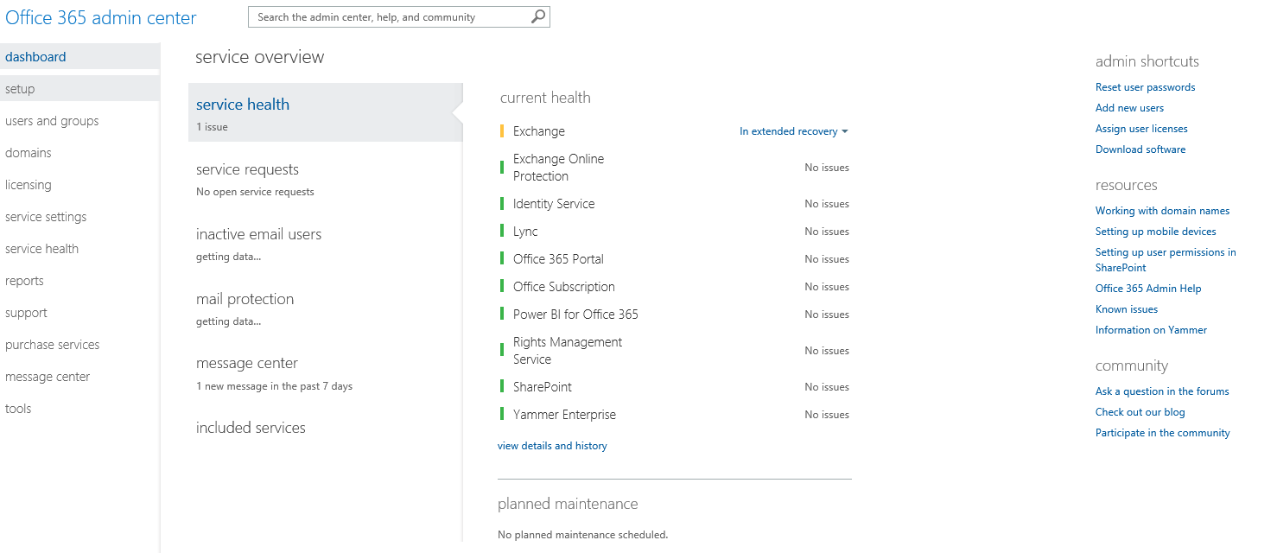
Office 365 Admin Center

Slide 12
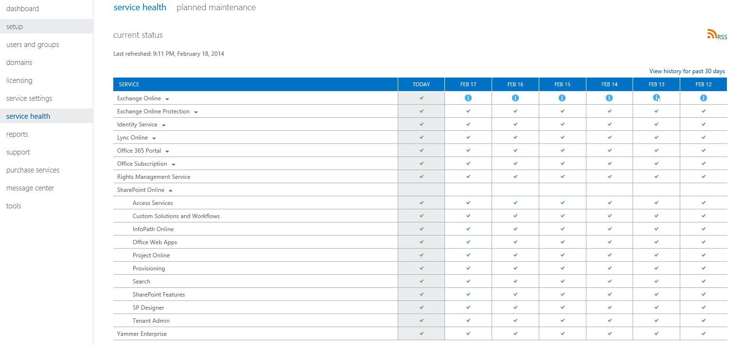
Service Health

Slide 13
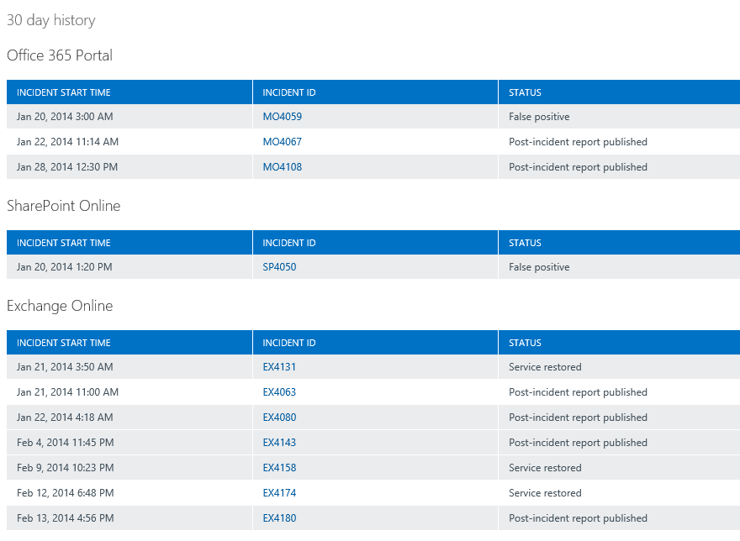
Prior Incidents

Slide 14
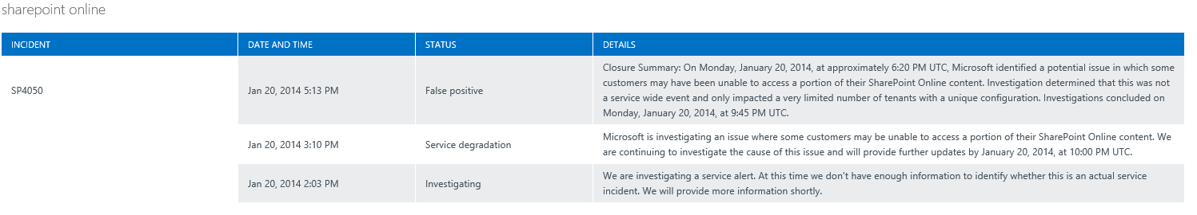
Incident Details

Slide 15
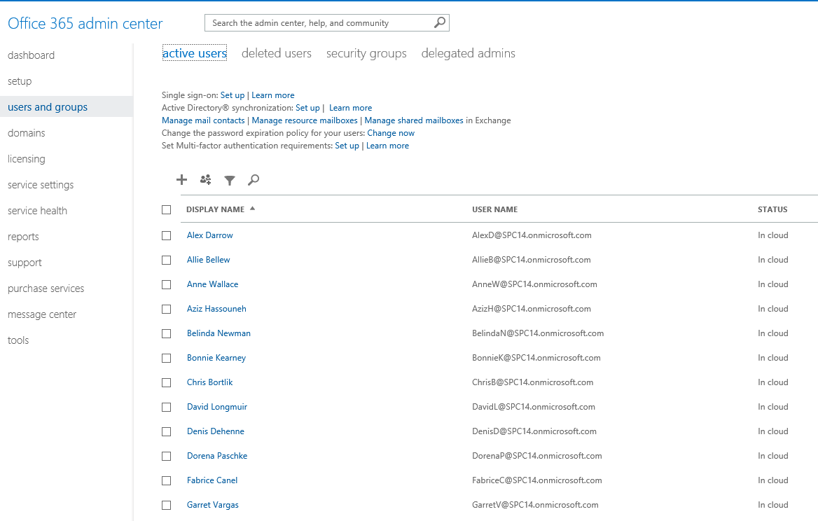
Users & Groups

Slide 16
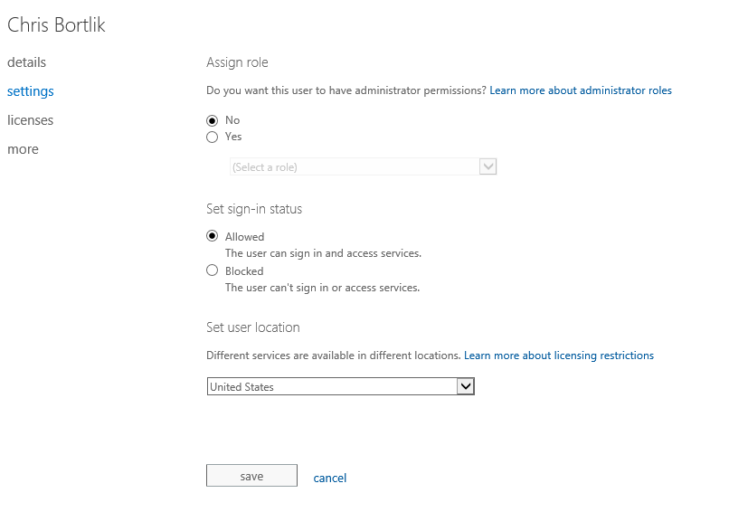
User Settings

Slide 17
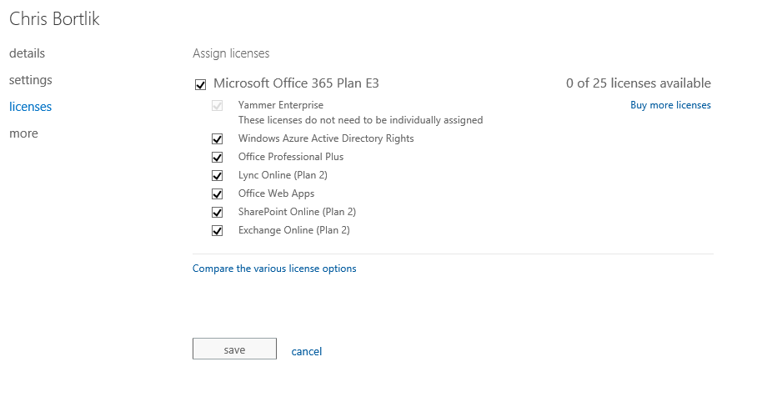
User License Assignment

Slide 18
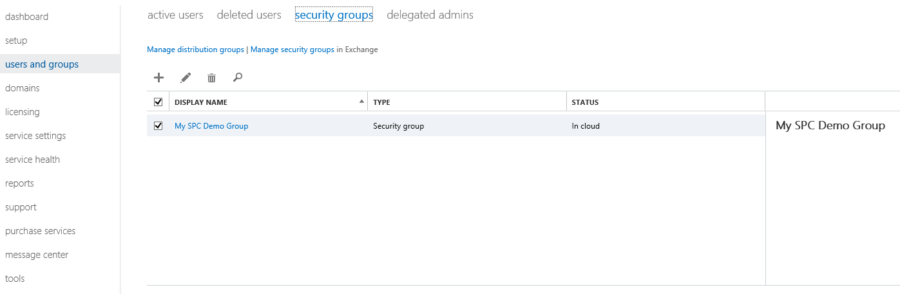
Security Groups

Slide 19
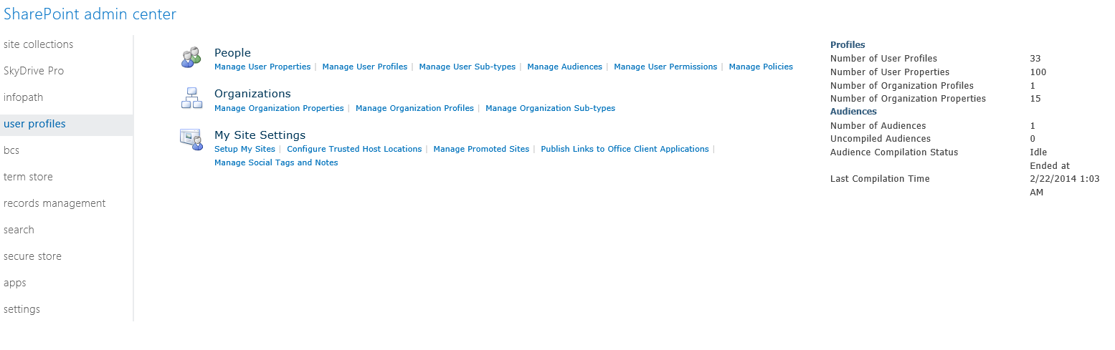
Manage User Profiles

Slide 20
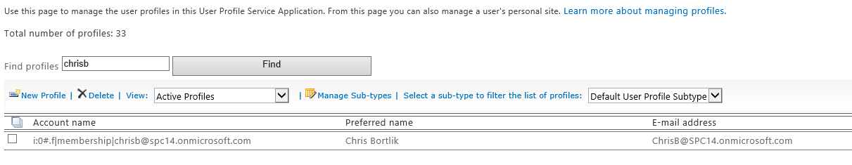
Find User Profile

Slide 21
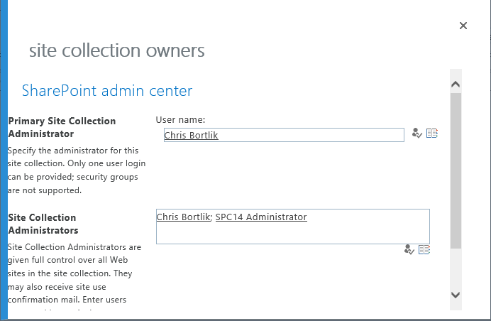
Add Site Collection Owner

Slide 22
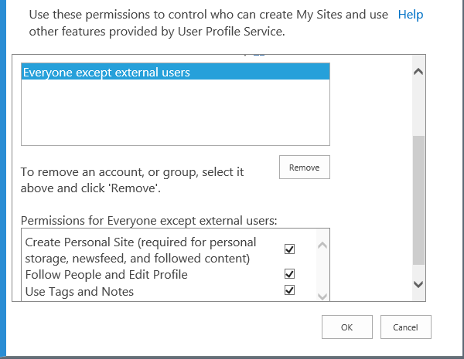
Manage User Permissions

Slide 23
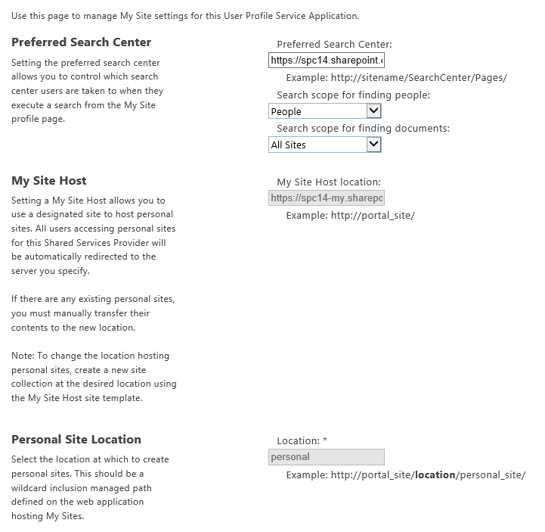
Setup My Sites

Slide 24
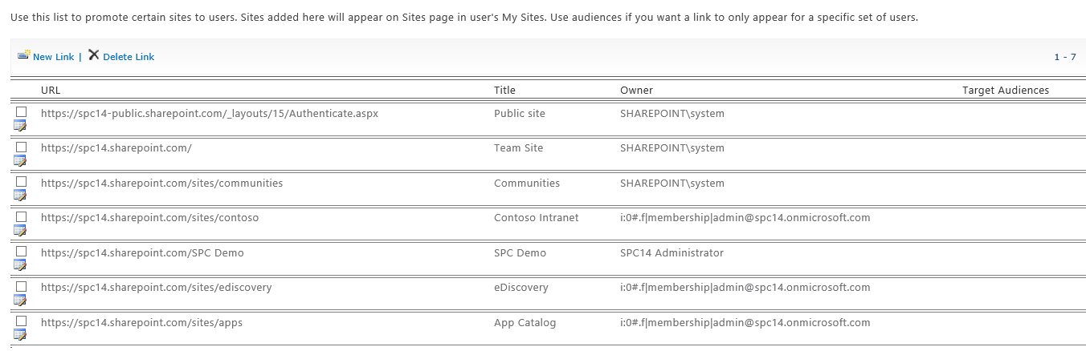
Manage Promoted Sites

Slide 25
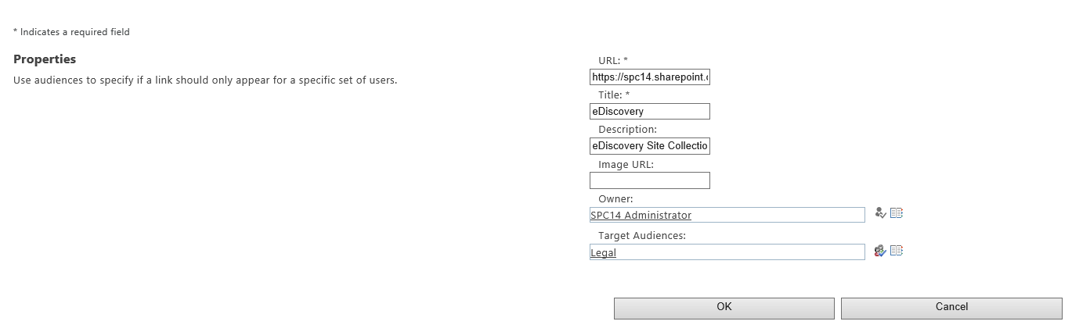
Audience Targeting for Promoted Sites

Slide 26
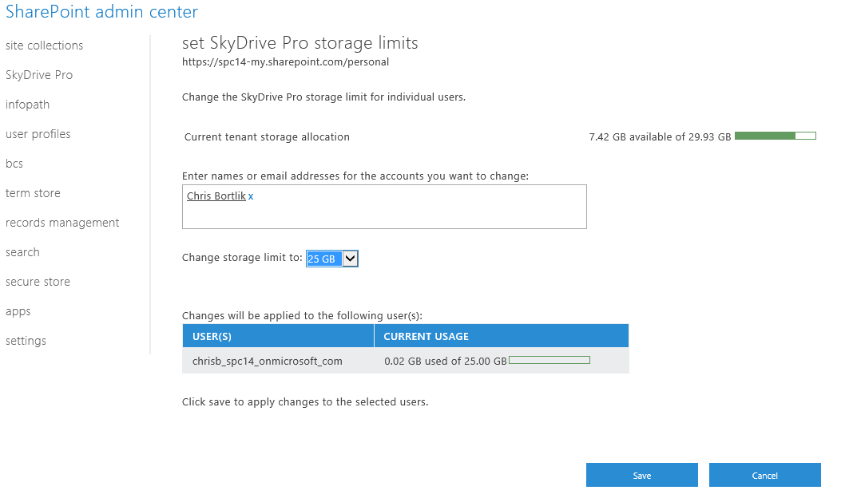
Manage SkyDrive Pro Storage Allocation

Slide 27
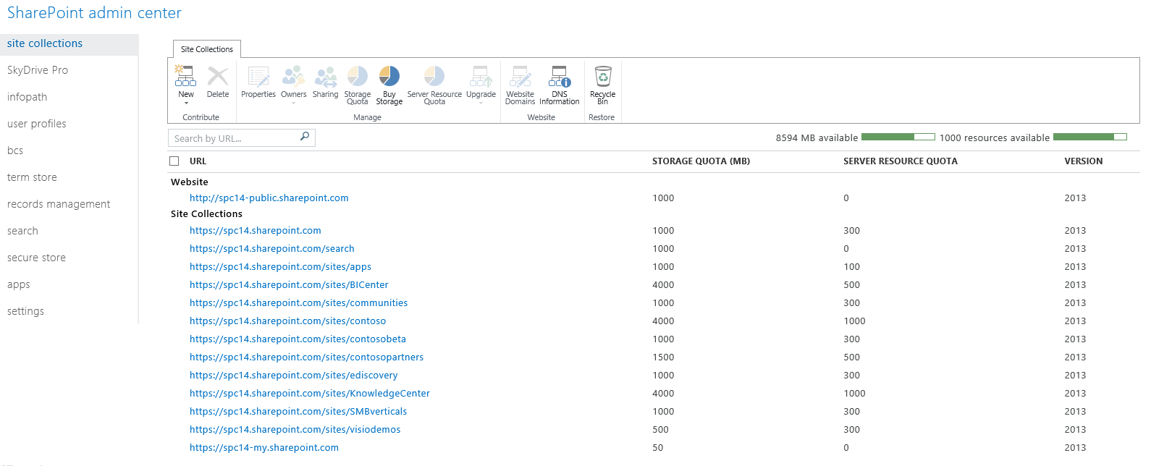
SharePoint Online Admin Center

Slide 28
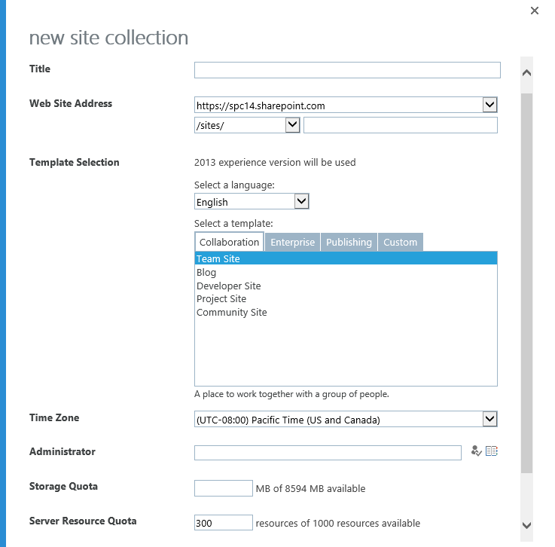
Create Site Collection

Slide 29
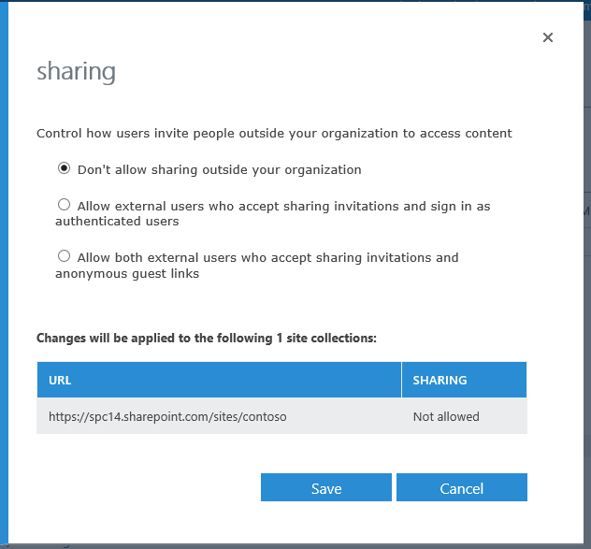
External Sharing

Slide 30
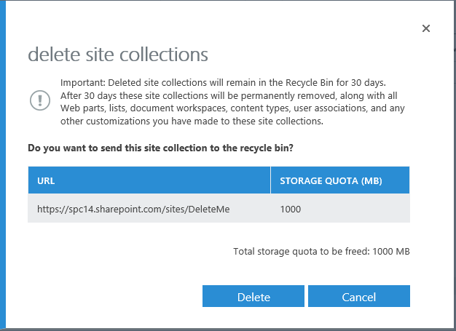
Delete Site Collection

Slide 31
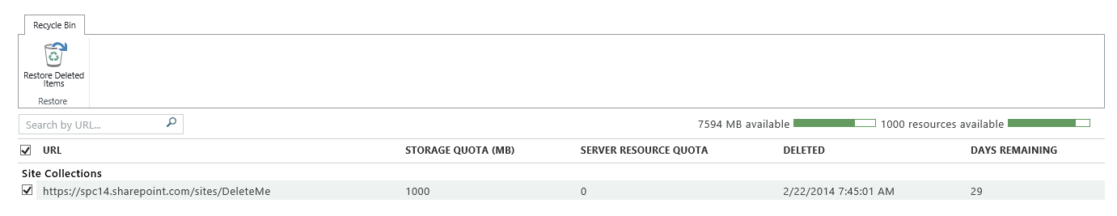
Site Collection Recycle Bin

Slide 32
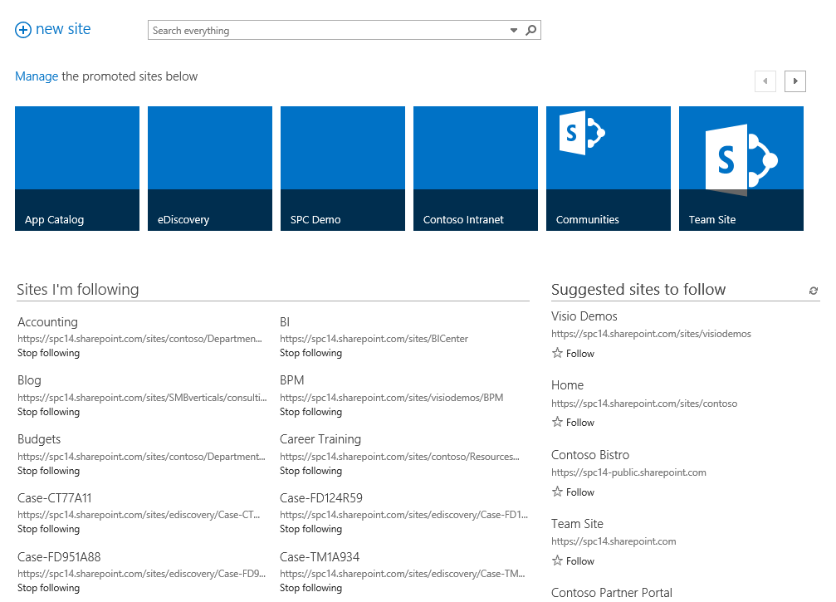
Sites

Slide 33
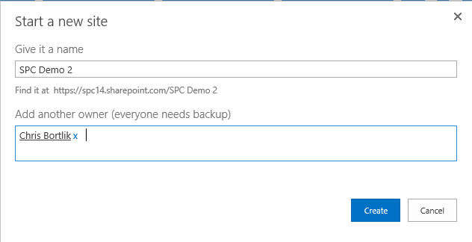
Self Service Site Provisioning

Slide 34
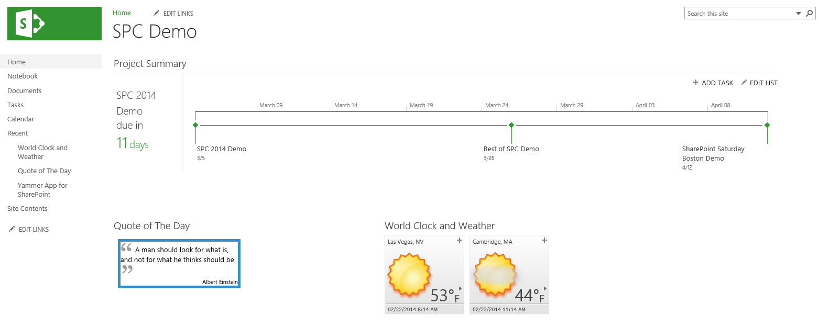
SPC Demo Team Site

Slide 35
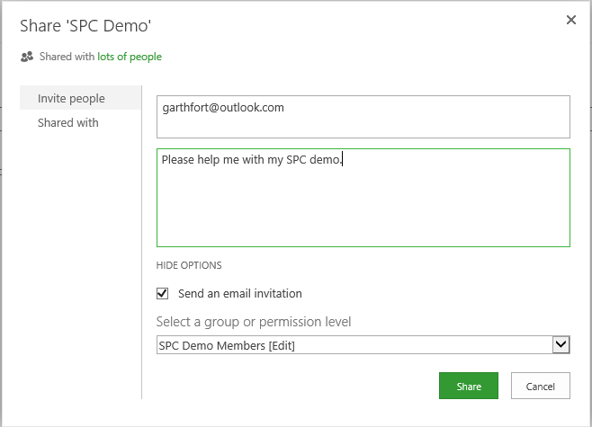
Share Site with External User

Slide 36
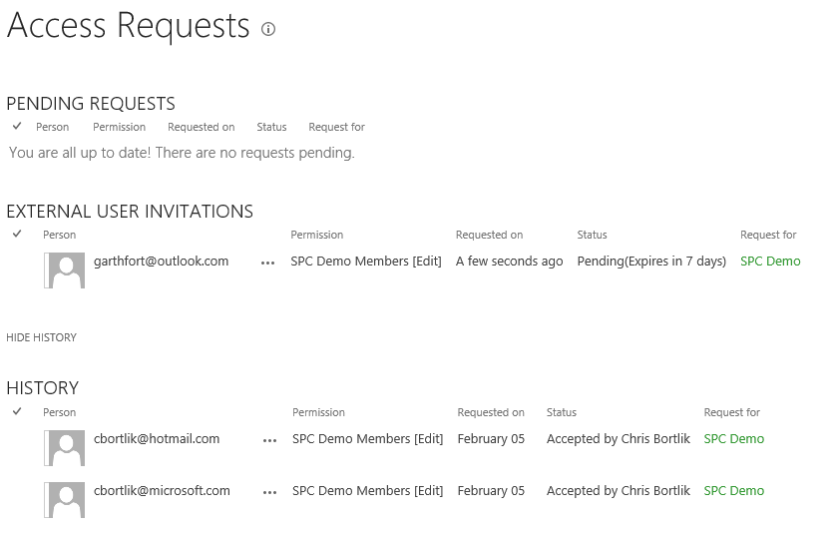
Manage External Access Requests

Slide 37
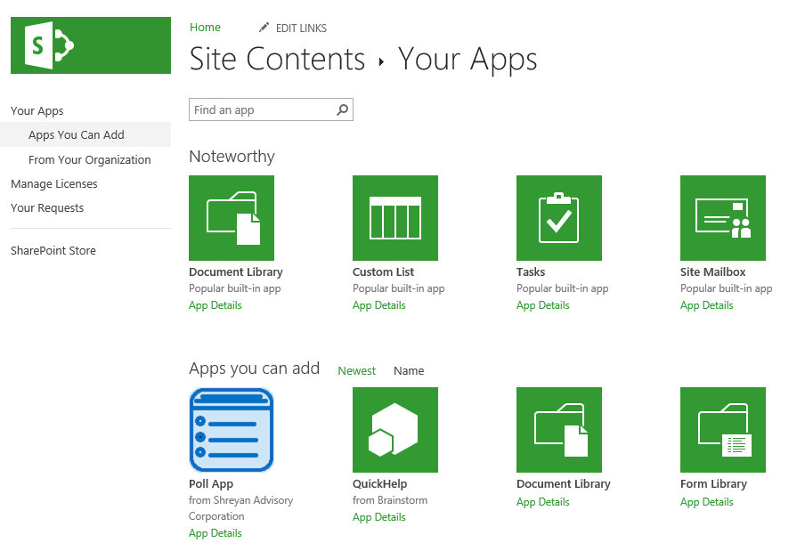
Add an App

Slide 38
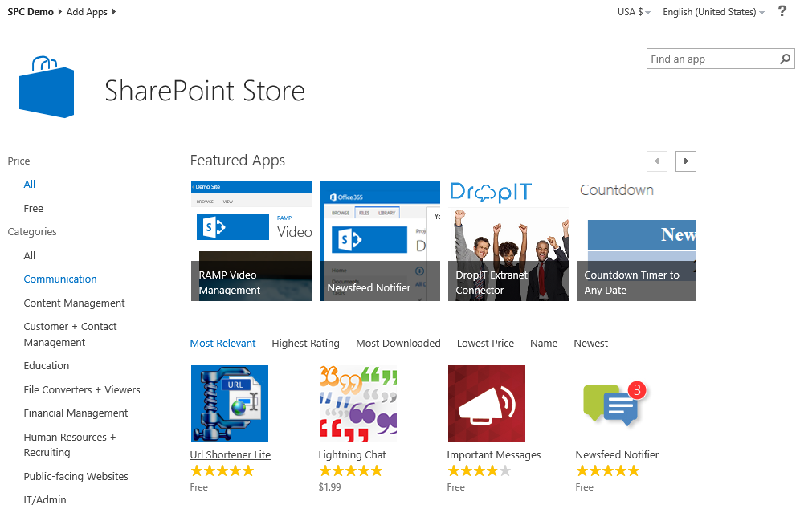
SharePoint Store

Slide 39
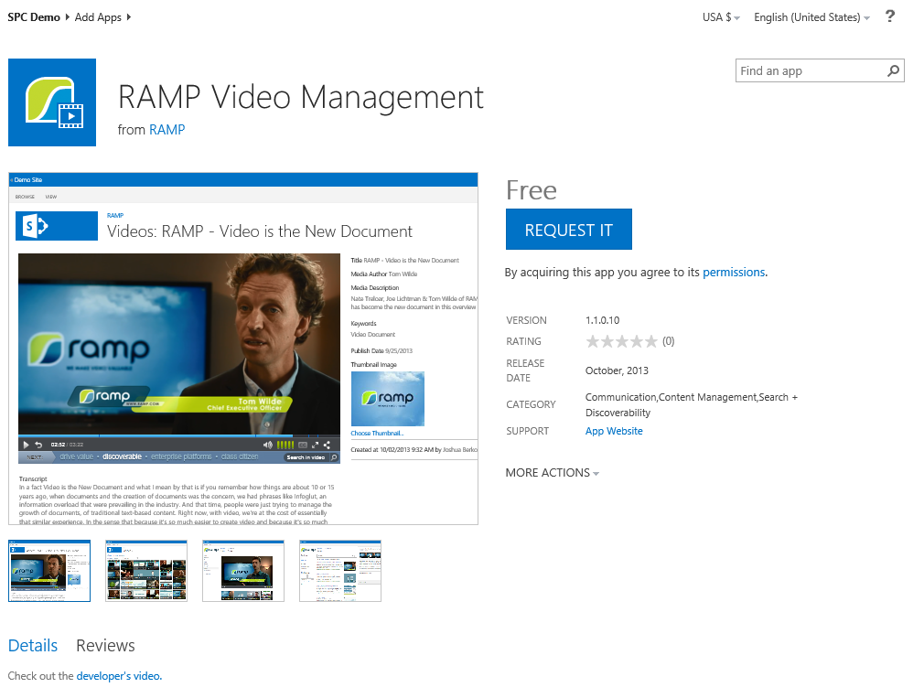
Request an App

Slide 40
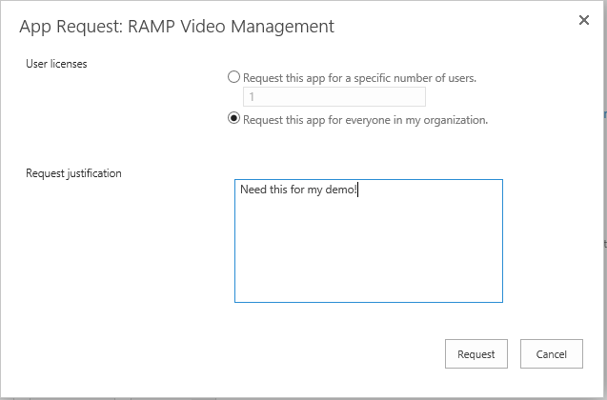
Request an App

Slide 41
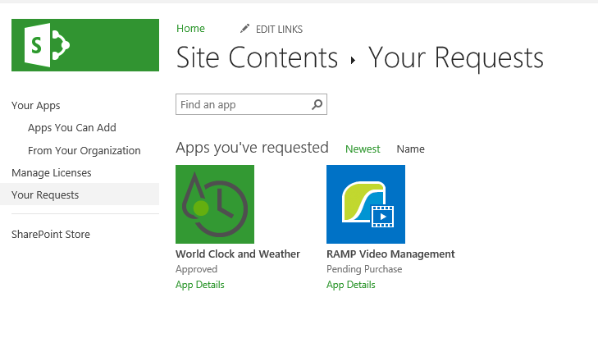
View App Requests

Slide 42
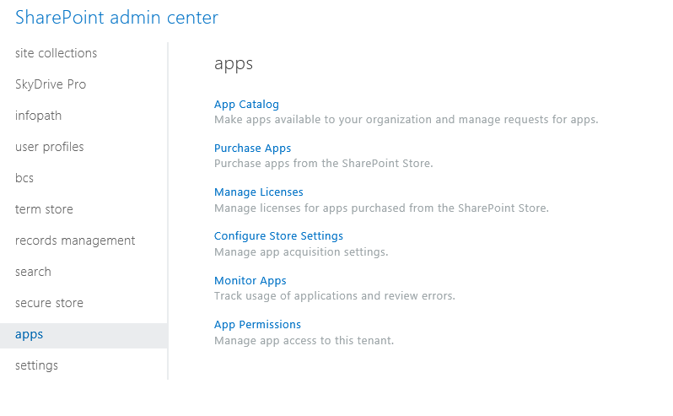
Manage Apps

Slide 43
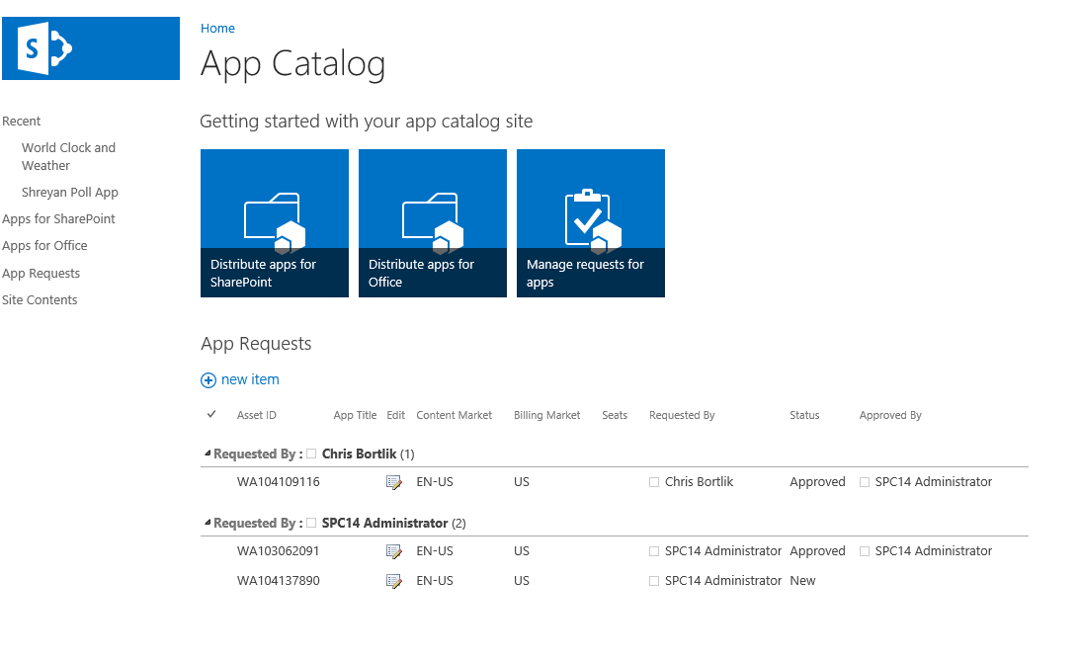
App Catalog

Slide 44
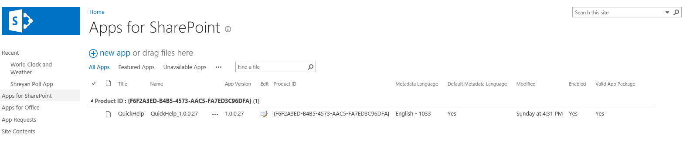
Distribute SharePoint Apps

Slide 45
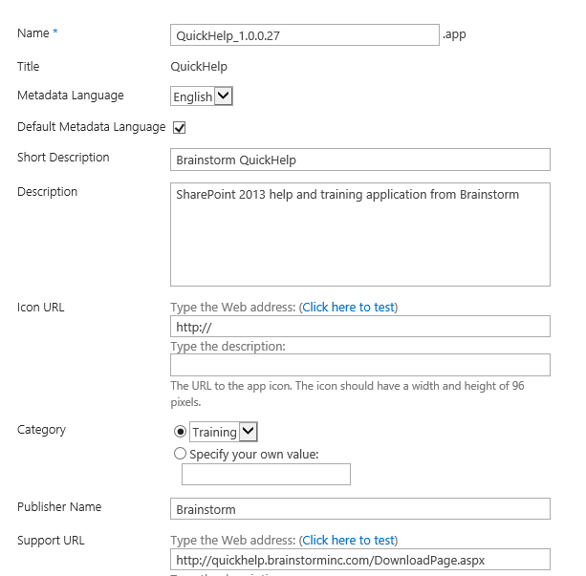
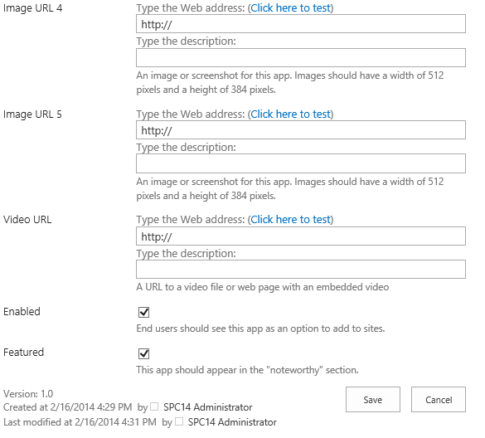
Application Properties

Slide 46
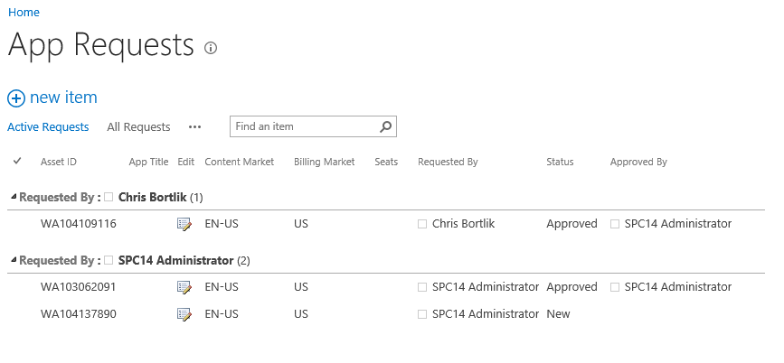
Manage App Requests

Slide 47
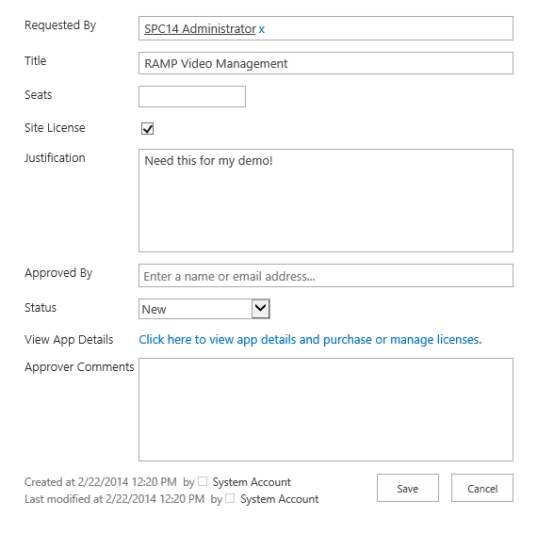
Approve App Request

Slide 48
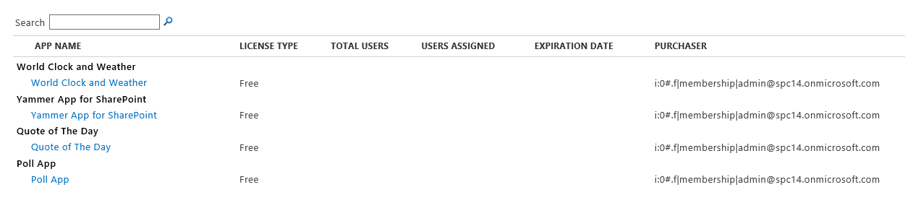
Manage App Licenses

Slide 49
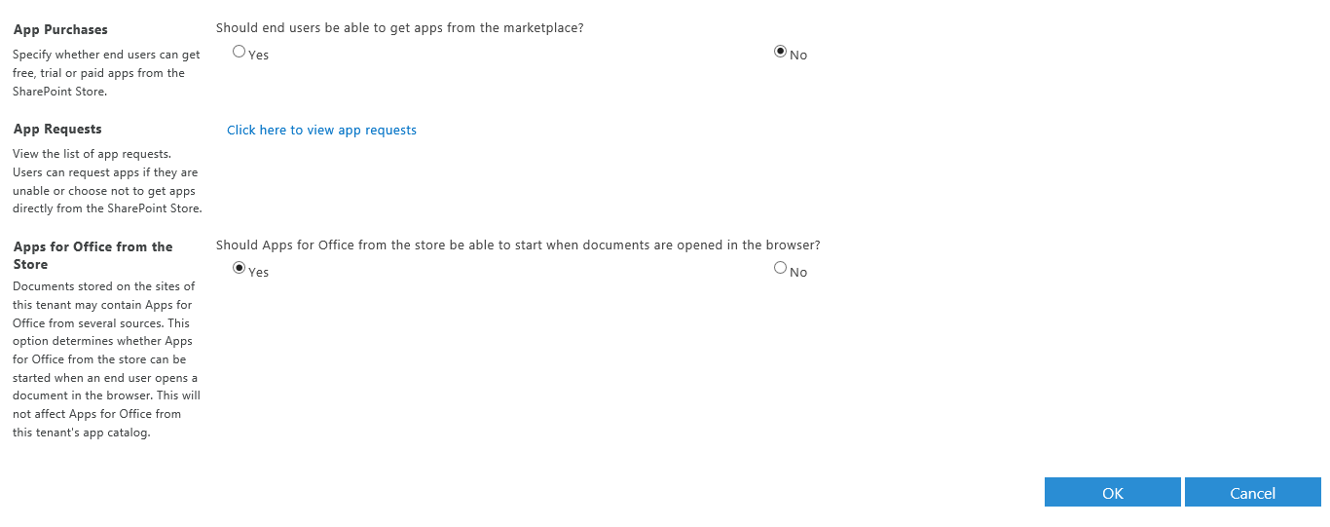
Manage App Store Settings

Slide 50
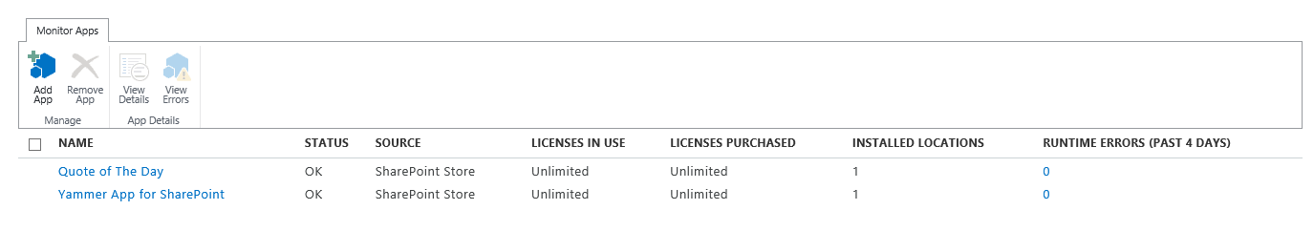
Monitor Apps

Slide 51
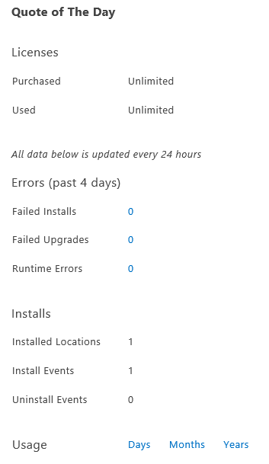
App Monitoring

Slide 52
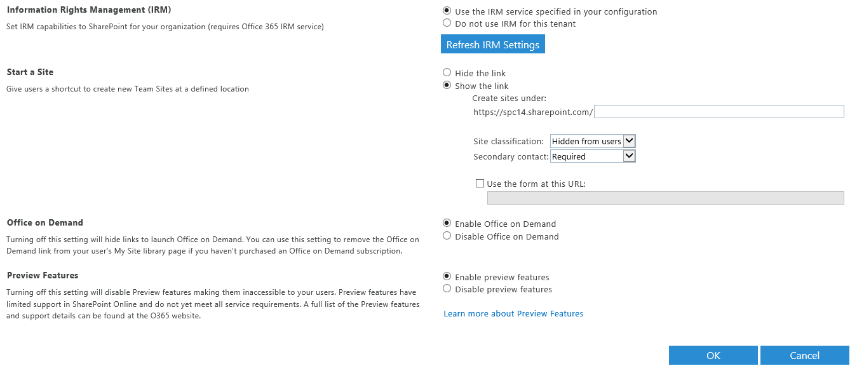
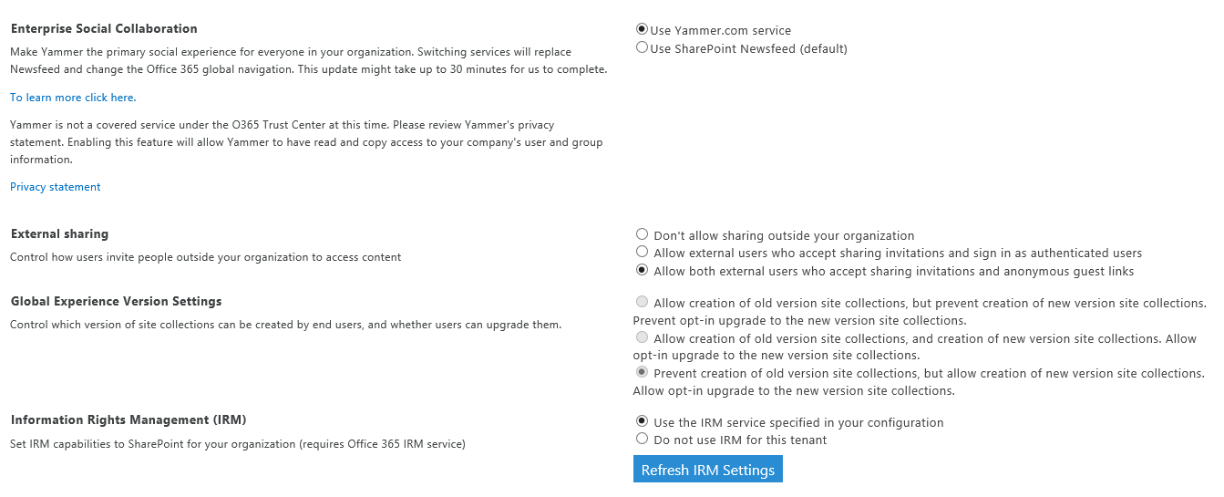
General SharePoint Online Settings

Slide 53
New Admin Features Coming Soon!

Slide 54
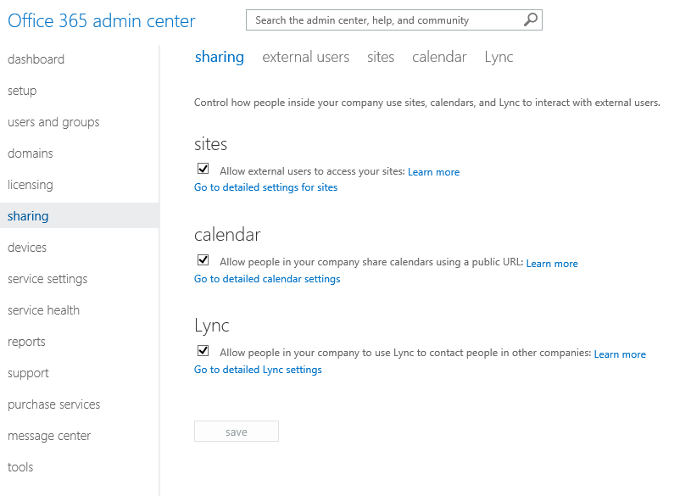
Sharing

Slide 55
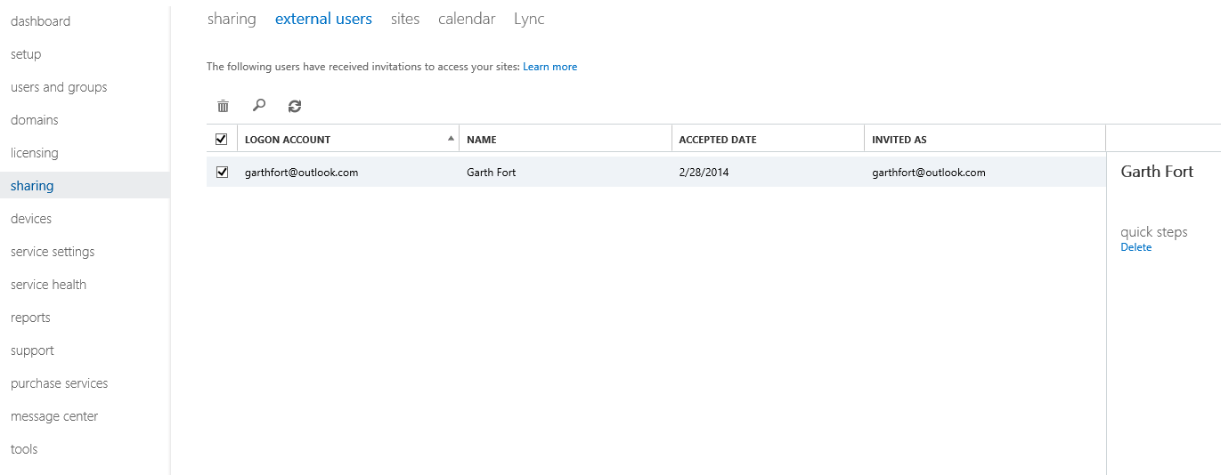
External User Management

Slide 56
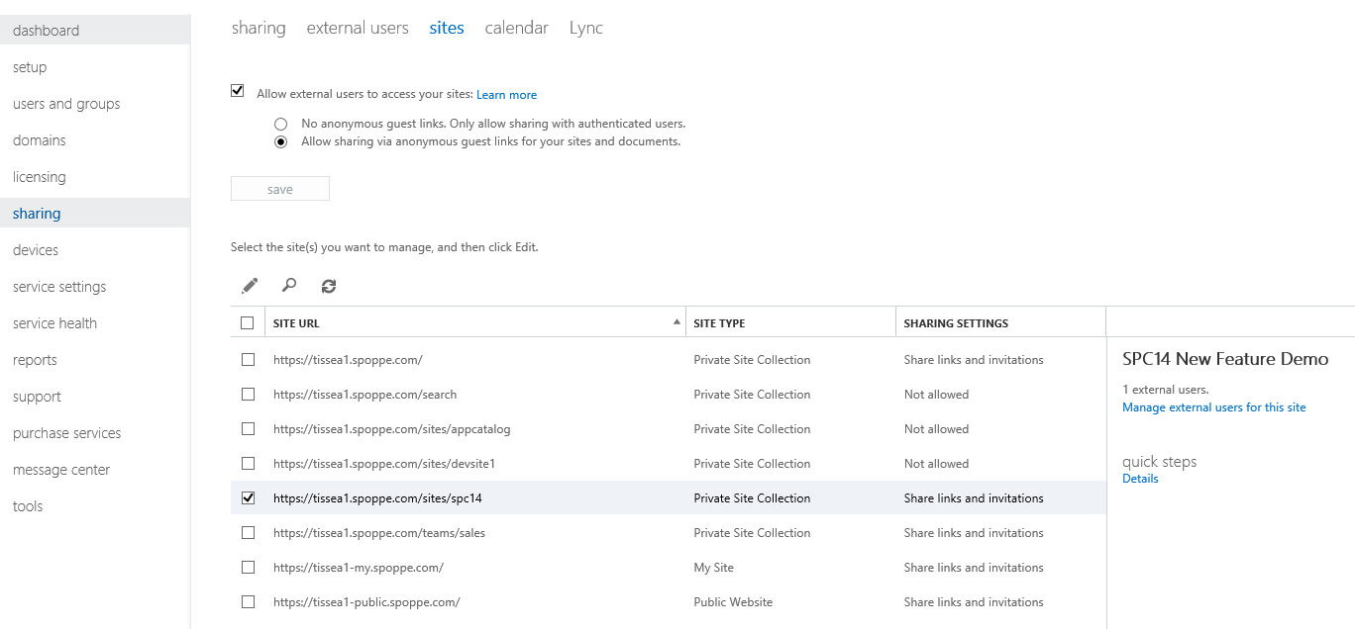
Site Sharing Settings

Slide 57
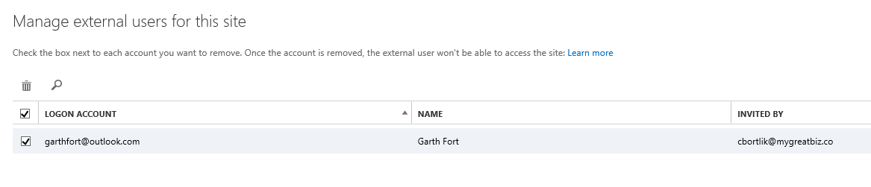
Manage External Users

Slide 58

Manage Site Sharing

Slide 59

OneDrive for Business Quota Management

Slide 60

User Based Storage Management

Slide 61

OneDrive for Business Reports

Slide 62

Simplified Admin Experience + More Control

Slide 63
PowerShell Scenarios

Slide 64
Key Tools
SharePoint Online Management Shell
Command Builder
PowerShell ISE

Slide 65
Demo
PowerShell

Slide 66

SharePoint Online Management Shell

Slide 67

Command Builder

Slide 68

Windows PowerShell ISE

Slide 69

Command Help

Slide 70
Advanced Admin Scenarios

Slide 71

Advanced Self Service Site Collection Provisioning

Slide 72
Additional Automation Options
Client Side Object Model (CSOM)
Hosting Apps in Azure
3rd Party Tools

Slide 73
Resources

Slide 74

SharePoint Online Service Description
http://aka.ms/sposd

Slide 75

SharePoint Online Limits
http://aka.ms/spolimits

Slide 76

SharePoint Online Hybrid
http://aka.ms/spohybrid

Slide 77
Wrap Up

Slide 78
Session Summary
SharePoint Online Fundamentals
SharePoint Online Admin Center Scenarios + New Features
PowerShell + Advanced Admin Scenarios
Resources

Slide 79
Related SPC 2014 Sessions
Using Windows PowerShell with SharePoint 2013 & SharePoint Online
Governing & configuring divisional sites in an enterprise environment
Site provisioning techniques with SharePoint apps

Slide 80
Questions?
Chris Bortlik
cbortlik@microsoft.com
@cbortlik
http://blogs.technet.com/cbortlik

Slide 81

© 2014 Microsoft Corporation. All rights reserved. Microsoft, Windows, and other product names are or may be registered trademarks and/or trademarks in the U.S. and/or other countries.
The information herein is for informational purposes only and represents the current view of Microsoft Corporation as of the date of this presentation. Because Microsoft must respond to changing market conditions, it should not be interpreted to be a commitment on the part of Microsoft, and Microsoft cannot guarantee the accuracy of any information provided after the date of this presentation. MICROSOFT MAKES NO WARRANTIES, EXPRESS, IMPLIED OR STATUTORY, AS TO THE INFORMATION IN THIS PRESENTATION.

Slide 82
Build Your Plan …
Review SharePoint 2013 Features
Inventory Existing SharePoint Environment
Compare SharePoint Online vs.
On Premises
What Services & Features Are Required?

Slide 83
Content Migration Options
Archive old sites (read only mode), clean-up, & build new sites for new content
Manual (e.g. OneDrive for Business, Windows Explorer, browser)
Scripts
3rd party tools

Slide 84
Migration Planning – Low Hanging Fruit
OneDrive for Business
Team/Project Sites
Secure Extranet
Yammer

